Slide 1
Campus Recruitment - 2014

Slide 2
Campus Recruitment - Objectives
Planning to recruit around 50 - 75 resources from various Engineering Colleges in Kerala.
50 % of this to come from 2013-14 pass-out batch. Expected Joining Date : 17-Nov-2014
50 % to come from students who will pass-out in 2015. Expected Joining Date : July 2015

Slide 3
Campus Recruitment – Qualification Criteria
B.Tech / M.Tech. – Computer Science or IT or MCA or M.Sc – Computer Science
Passed with 65 % mark scored consistently for SSLC, +2, Professional course
Good Analytical and Communication Skills
Very good in any one Programming Language
Good in Software Engineering basics and Object Oriented Concepts

Slide 4
Campus Recruitment – Selection Process
Written Test – Objective Type – 1 hour
Programming Test – Any Language – 1 hour
Group Discussion – 20 min
Personal Interview

Slide 5
Campus Recruitment – Exam Centre & Probable Dates
Trivandrum, Kochi, Kottayam, Trissur, Calicut
Trivandrum, Kochi – 31-Oct-2014 (proposed)
Kottayam, Trissur – 04-Nov-2014
Calicut – 10-Nov-2014
(Exam centers to be decided; request recommendations)

Slide 6
Experion: Who We Are
New generation technology provider operating globally
Serving Transportation, Healthcare & Retail industries
2 development centers; 200 strong
Enterprise/ SME focus
(Product Engineering Services, IT services & Products )
Product - FieldMax®: facilitates 150,000+ POS/POP in retail
xPort: Experion’s IT solution suite for ports of tomorrow

Slide 7
Why Experion ?
Experion is relatively a young company but has been one of the fastest growing company in Technopark riding on its focus on emerging technologies. It has grown from 10 staff in 2008 to the current 200.
Experion has been working in collaboration with technology pioneers from UK and Australia in the fields of transportation safety, traffic engineering in surface transportation and advanced fault isolation techniques for aircraft maintenance. For the past 4 years there had been contracted R&D work undertaken by Experion in very advanced areas of transportation such as carbon foot print monitoring, emission audits, safety analytics etc from our principals in the UK which is now extending to the emerging areas in managed traffic, road asset management and radio guidance. Another area where significant R&D has been undertaken by Experion was in the area of Fault Isolation for aircraft maintenance using natural language processing and machine learning using very advanced algorithms and combination of disparate technologies and software platforms. Accurate Fault Isolation techniques can enhance the uptime of aircrafts and enhance the profitability for airlines.
Experion has been also working in web and mobile application space doing product development work for customers from US, Europe and Australia. Experion has long term contracts with some of its principals in the form of enterprise product development and maintenance contracts.
Experion is wanting to expand its workforce to support all the above areas and build up a solid team of high quality professionals to its existing team.
Experion has an extremely open work culture and employees have ample opportunities for learning and professional growth, primarily supported by its highly experienced senior management team and architects covering multiple technology practices. Experion is also active in CSR work with its initiative called “compassion” run by its employees that provides support to orphanages, old age homes and cancer patients in Kerala.

Slide 8
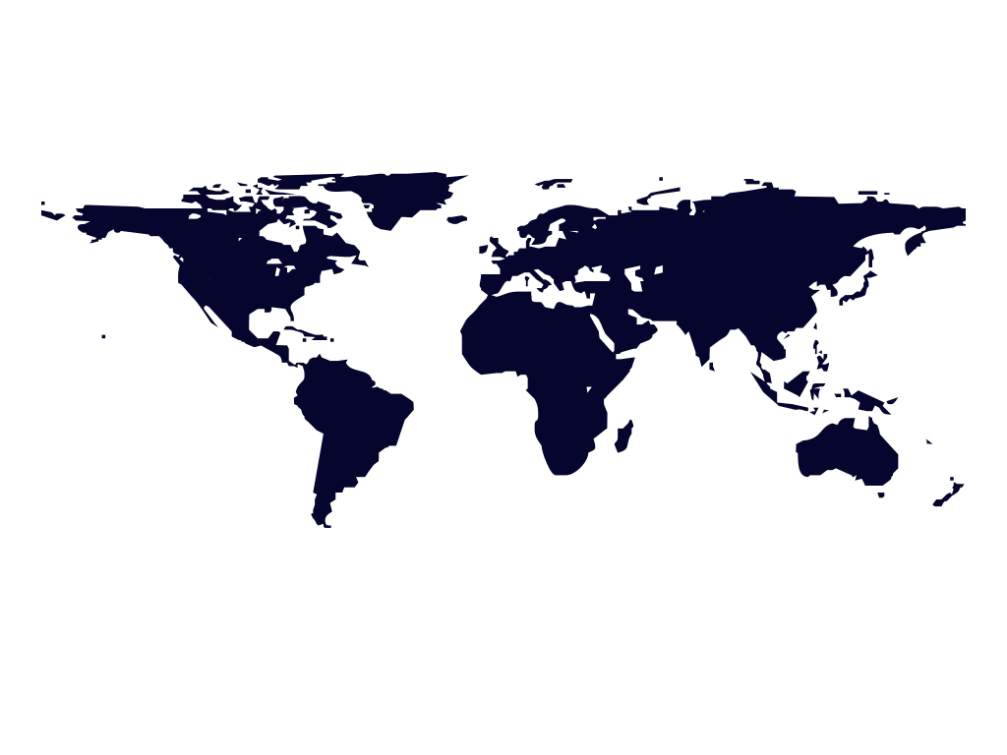
Experion Offices
Netherlands
Germany
New York
Switzerland
Dallas
Kochi
Trivandrum
Melbourne

